Slide 1
You Shall Not (by)Pass!
Practical, Secure, and Fast PKU-based Sandboxing
Alexios Voulimeneas, Jonas Vinck, Ruben Mechelinck, Stijn Volckaert
Notes:
Hello everyone, Thanks for coming to my presentation.
My name is Alexios Voulimeneas, and I am a postdoc in the distrinet research group at KU Leuven.
Today I will present our work with the title You Shall Not (by)Pass! Practical, Secure, and Fast PKU-based Sandboxing.

Slide 2
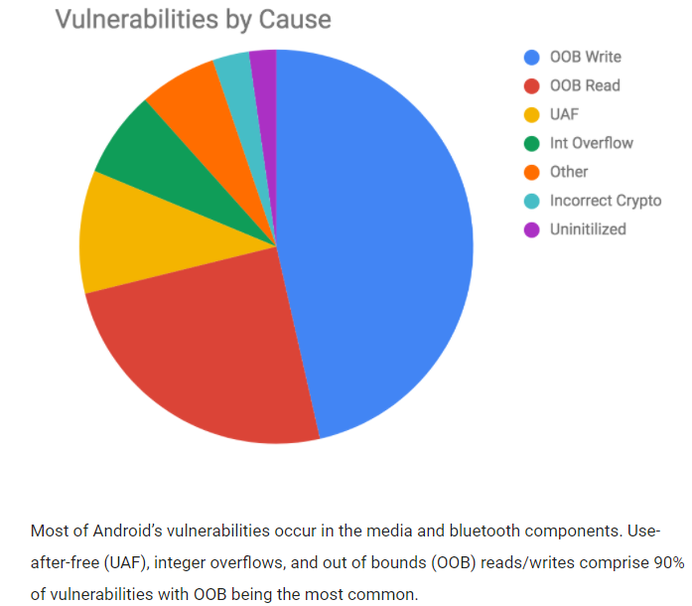
Notes:
Google recently revealed that 70% of the critical security bugs in Chromium are memory safety bugs,
and also estimated that memory corruptions account for 90% of the vulnerabilities in the Android operating system. Apple and Microsoft have been reporting similar numbers for the past ten years.
Hackers can exploit these memory errors to read or corrupt sensitive program state and data.
***Additional content***
This sensitive data might include encryption keys, passwords, user credentials et cetera, et cetera.

Slide 3
Compartmentalization
Notes:
A good practice to deal with such vulnerabilities is to compartmentalize programs into trusted and untrusted components,

Slide 4
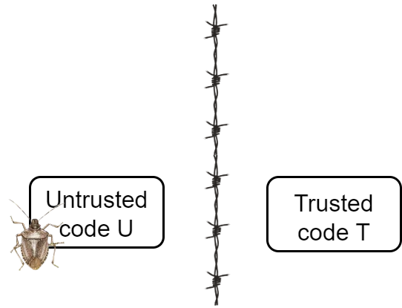
Compartmentalization
Notes:
and isolate untrusted components that could contain bugs from the trusted ones.

Slide 5
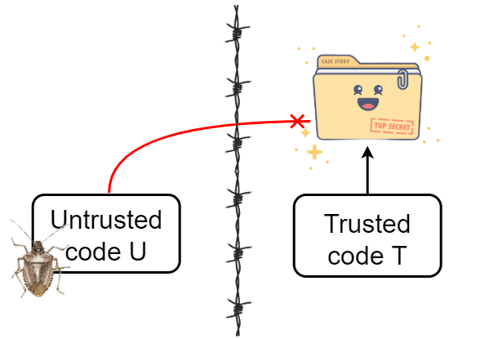
Compartmentalization
Notes:
Typically, we isolate the components in a way that the trusted code can access trusted memory that contains secrets like cryptographic keys, while the untrusted code cannot.
Consequently, attackers cannot exploit bugs in the untrusted code to compromise the confidentiality or integrity of trusted memory.

Slide 6
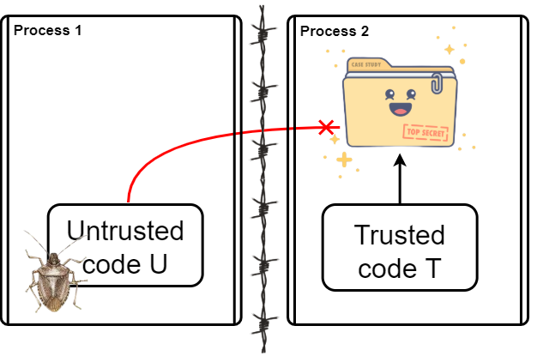
Process-Level Isolation
Enforced by the OS
Performance issues
Limited granularity
4
Notes:
Compartmentalization techniques traditionally relied on running components as separate processes since process-level isolation is enforced by modern OSes.
Google Chrome, for example, runs a single main process alongside a content process for every individual browser tab.
Unfortunately, these approaches can incur significant run-time overhead and offer limited flexibility to software developers.

Slide 7
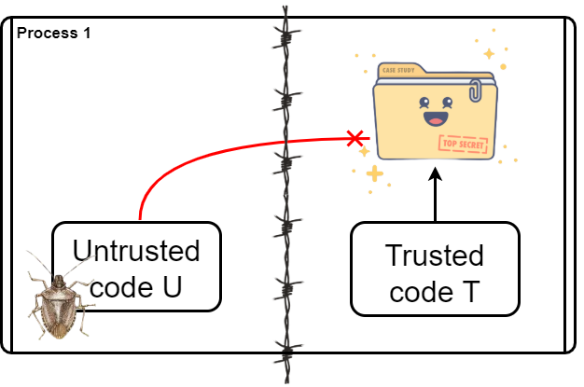
In-Process Isolation
Avoids (most) performance issues
Fine-grained isolation
Not enforced by the OS
4
Notes:
The research community and industry have, therefore, proposed techniques to separate components within the same process.
However, we need to use tricks to enable in-process isolation, since it is not enforced by the OS.

Slide 8
In-Process Isolation (2)
Several techniques to enable in-process isolation
OS abstractions
Hardware virtualization support
ARM memory domains
Custom hardware
Supervisor Mode Access Prevention (SMAP)
Memory Protection Keys for Userspace (PKU)
Notes:
For this presentation, we focus only on the approaches that leverage memory protection keys for user space or PKU for short.

Slide 9
Memory Protection Keys for Userspace (PKU)
Available on recent Intel and AMD server and desktop CPUs
Tag memory pages with one of 16 available protection keys (PKEYS)
Notes:
PKU is a hardware feature that is available on recent Intel and AMD server and desktop CPUs.
Developers can use a new system call to tag memory pages with one of 16 available protection keys.

Slide 10
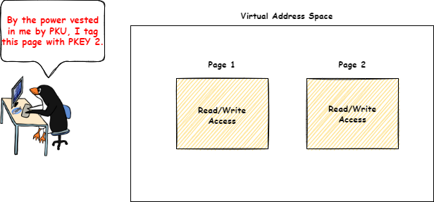
Memory Protection Keys for Userspace (PKU)
Available on recent Intel and AMD server and desktop CPUs
Tag memory pages with one of 16 available protection keys (PKEYS)
Notes:
For example, assume these two readable and writable memory pages.

Slide 11
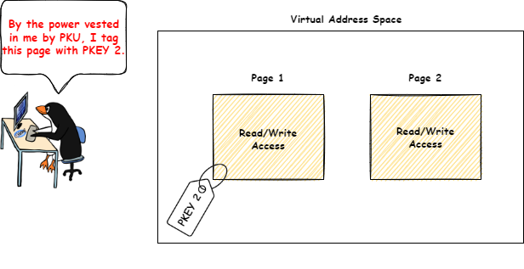
Memory Protection Keys for Userspace (PKU)
Available on recent Intel and AMD server and desktop CPUs
Tag memory pages with one of 16 available protection keys (PKEYS)
Notes:
A developer can tag Page 1 with protection key 2.

Slide 12
Memory Protection Keys for Userspace (PKU)
Available on recent Intel and AMD server and desktop CPUs
Tag memory pages with one of 16 available protection keys (PKEYS)
New unprivileged 32-bit register (PKRU)
PKRU Register
Protection Key | PKEY 15 |  |  | PKEY 2 |  | PKEY 1
Access/Write Disable | WD | AD | … | WD | AD | WD | AD
Bits | 0 | 0 |  | 0 | 0 | 0 | 0
PKEY 2 |  | PKEY 1 |  | PKEY 0
WD | AD | WD | AD | WD | AD
0 | 0 | 0 | 0 | 0 | 0
Notes:
PKRU, a new user-mode register, contains two bits for each protection key, that are used to control read/write accesses to tagged pages.
Specifically, the hardware checks these bits during memory accesses for all the pages that are tagged with a key.

Slide 13
Memory Protection Keys for Userspace (PKU)
Available on recent Intel and AMD server and desktop CPUs
Tag memory pages with one of 16 available protection keys (PKEYS)
New unprivileged 32-bit register (PKRU)
Accessed with new instructions: wrpkru, rdpkru
Accessed with xrstor (if bit 9 of eax register is set)
PKRU Register
Protection Key | PKEY 15 |  |  | PKEY 2 |  | PKEY 1
Access/Write Disable | WD | AD | … | WD | AD | WD | AD
Bits | 0 | 0 |  | 0 | 0 | 0 | 0
PKEY 2 |  | PKEY 1 |  | PKEY 0
WD | AD | WD | AD | WD | AD
0 | 0 | 0 | 0 | 0 | 0
Notes:
We can read and modify the PKRU register with xrstor or new unprivileged instructions; rdpkru and wrpkru.
Consequently, we can quickly enable/disable access to memory domains that are associated with the protection keys.

Slide 14
Memory Protection Keys for Userspace (PKU)
Available on recent Intel and AMD server and desktop CPUs
Tag memory pages with one of 16 available protection keys (PKEYS)
New unprivileged 32-bit register (PKRU)
Accessed with new instructions: wrpkru, rdpkru
Accessed with xrstor (if bit 9 of eax register is set)
PKRU Register
Protection Key | PKEY 15 |  |  | PKEY 2 |  | PKEY 1
Access/Write Disable | WD | AD | … | WD | AD | WD | AD
Bits | 0 | 0 |  | 0 | 0 | 0 | 0
PKEY 2 |  | PKEY 1 |  | PKEY 0
WD | AD | WD | AD | WD | AD
1 | 0 | 0 | 0 | 0 | 0
Notes:
For example, a developer can set the write disable bit for protection key 2 in the PKRU register to revoke write accesses to Page 1 that is tagged with this key.

Slide 15
PKU-based Memory Isolation
Notes:
Several memory isolation schemes leverage PKU to isolate trusted from untrusted components.
***Additional content***
VIP-2021, NoJitsu-2020, Jenny-2022, FlexOS-2022, PKRUSafe-2022, CryptoMPK-2022, ERIM-2019, Hodor-2019, IskiOS-2021, XOMSwitch-2018, SGXLock-2022, CubicleOS-2021, Enclosure-2021, libmpk-2019, TheEndoKernel-2021, μTiles-2020, ShiningLightOnShadowStacks-2019, MemSentry-2017, MonGuard-2020, Seimi-2020
https://www.jasondavies.com/wordcloud/

Slide 16
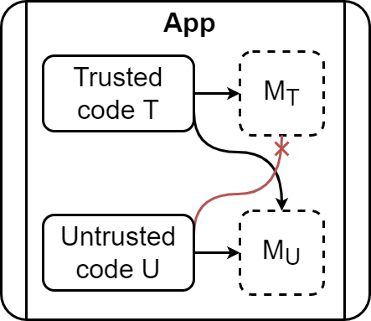
PKU-based Memory Isolation
Notes:
These systems typically tag memory pages containing trusted state and data with a different protection key than the other pages, thereby placing them in two different memory protection domains, the trusted and the untrusted.
The trusted code is then allowed to access both memory domains, whereas untrusted code can only access the untrusted memory domain.

Slide 17
PKU is Not Secure (On its Own)
Via exploitable wrpkru and xrstor instructions
(unsafe instructions)
PKRU is unprivileged
Attackers that hijack control flow can modify PKRU
Code may contain unsafe instructions
Attackers can introduce new unsafe instructions
Should be used in conjunction with other mitigations (e.g., CFI)
Notes:
However, PKU is not secure on its own.
PKRU is a user-mode register, and attackers that hijack control flow can abuse exploitable wrpkru and xrststor instructions to modify it.
Code may contain such so-called unsafe instructions or attackers can force the application to introduce new ones.
Consequently, PKU should be used together with other mitigations such CFI that come with their own challenges.

Slide 18
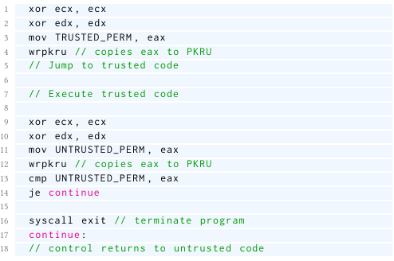
ERIM/Hodor
Compartmentalize applications
Two memory domains (M_{T} and M_{U})
Trusted (T) and untrusted (U) components
Transferring control from U to T or vice versa via exploit-proof call gates
ERIM’s call gate
Notes:
ERIM and Hodor proposed PKU-based memory isolation schemes that do no rely on additional mitigations.
Both systems separate applications in trusted and untrusted components, and use two memory domains.
In addition, they transfer control from untrusted to trusted components or vais versa only via exploit-proof call gates.

Slide 19
ERIM/Hodor
Compartmentalize applications
Two memory domains (M_{T} and M_{U})
Trusted (T) and untrusted (U) components
Transferring control from U to T or vice versa via exploit-proof call gates
ERIM’s call gate
Notes:
That only contain safe PKRU-modifying instructions.
***Additional content***
wrpkru followed by jmp to trusted code
wrpkru followed by code to ensure PKRU is unprivileged when exiting the gate

Slide 20
ERIM/Hodor
Compartmentalize applications
Two memory domains (M_{T} and M_{U})
Trusted (T) and untrusted (U) components
Transferring control from U to T or vice versa via exploit-proof call gates
ERIM’s call gate
Notes:
That only contain safe PKRU-modifying instructions.
***Additional content***
wrpkru followed by jmp to trusted code
wrpkru followed by code to ensure PKRU is unprivileged when exiting the gate

Slide 21
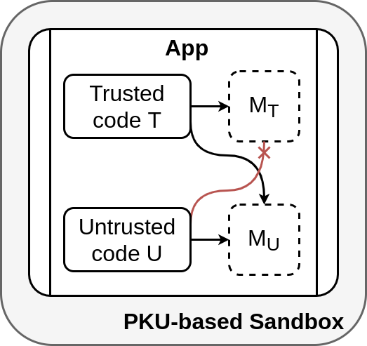
ERIM/Hodor
Eliminate unsafe instructions (ERIM)
Built-in PKU-based sandboxes
Scan new code for unsafe instructions
Mark pages containing unsafe instructions as non-executable (ERIM)
Leverage hardware breakpoints (Hodor)
Notes:
Both systems eliminate or detect unsafe instructions in applications using build-in PKU-based sandboxes.
ERIM uses binary rewriting to eliminate unsafe instructions in programs offline.
Then its sandbox scans new code for unsafe instructions and marks pages containing such instructions as non-executable.
Hodor’s sandbox works in a similar way, but instead of relying on binary rewriting it uses hardware breakpoints to vet unsafe instructions at run-time, and stop them before they do damage.

Slide 22
Challenges of PKU-based Sandboxing
Handling of unsafe instructions
PKU Pitfalls (Conor et al. 2020)
Inconsistencies of PT and PKU permissions
Mappings with mutable backings
Changing code by relocation
Influencing intra-process behavior with seccomp
Modifying trusted mappings
Race conditions in scanning
Signal context attacks
New PKU Pitfalls
Vetted unsafe instruction relocation
Incomplete debug register update
Notes:
Unfortunately, there are several challenges associated with PKU-based sandboxes.
For this talk, due to time constraints, I will focus on a subset of these challenges. You can check our paper for more details.

Slide 23
Handling of Unsafe Instructions
Notes:
Let’s start with the challenges related to handling of unsafe instructions.

Slide 24
Handling of Unsafe Instructions
We examined Hodor^{[1]} and ERIM^{[2]}
Hodor’s sandbox does not vet xrstor instructions
ERIM’s sandbox marks pages containing unsafe instructions as non-executable (after using binary rewriting to eliminate unsafe instructions offline)
Works for old systems
Usability or security issues for recent systems
[1] https://github.com/hedayati/hodor [2] https://github.com/vahldiek/erim
Notes:
First, it turns out that Hodor’s sandbox does not vet xrstor instructions at all, so attackers can abuse them.
Second, we discovered that ERIM’s approach works for old systems but not for recent ones.
The reason is that ERIM’s binary rewriter cannot eliminate all unsafe instructions in recent versions of binaries like libc and libm. Then ERIM’s sandbox marks pages containing such instructions as non-executable, which causes even trivial compartmentalized programs to terminate early, since these pages contain valid code that the programs use.
We can modify the sandbox to not mark these pages as non-executable, but this would lead to security issues.

Slide 25
PKU Pitfalls & New PKU Pitfalls
Notes:
To make things worse, attackers can bypass existing PKU-based sandboxes, using the kernel as a confused deputy.

Slide 26
PKU Pitfalls
Attackers can circumvent page table and PKU permissions
process_vm* system calls
/proc/self/mem file
Attackers can change the virtual address space to access isolated memory or modify T (e.g., by invoking pkey_mprotect from U)
Attackers can modify executable mappings with mutable backings
Perform I/O operations on their mutable backing files
Abusing multiple mappings of the same shared memory
Connor et al. PKU Pitfalls: Attacks on PKU-based Memory Isolation Systems, USENIX Security, 2020
Notes:
First, Attackers can circumvent page table and PKU permissions using specific system calls or by performing I/O operations to /proc/self/mem file.
Attacker can also bypass PKU-based sandboxes by changing the virtual address space
Another way to bypass PKU-based sandboxes is to add unsafe instructions to executable mappings,
either by directly modifying their backing files or by abusing multiple mappings of the same shared memory.

Slide 27
PKU Pitfalls (2)
Attackers can exploit the sandbox’s memory scanning
TOCTTOU race conditions
Inability of ptrace-based sandboxes to reliably identify the current executing domain
Bypass the sandbox and add unsafe
instructions to executable memory!
Connor et al. PKU Pitfalls: Attacks on PKU-based Memory Isolation Systems, USENIX Security, 2020
Notes:
Attacker can also exploit low implementation details of the sandboxes like the memory scanning operation. They were able to exploit “tock too” race conditions in the memory scanning, and also the fact that ptrace-based sandboxes cannot directly access PKRU
(so they use some non-reliable methods to determine the current executing domain).
In both cases the attackers managed to bypass the sandbox and add unsafe instructions to executable memory.

Slide 28
New PKU Pitfalls
Two new proof-of-concept attacks against PKU-based sandboxes
Vetted unsafe instruction relocation
Incomplete debug register update
They target Hodor’s instruction vetting mechanism
… but they can be generalized
Notes:
The aforementioned attacks were developed by Conor et al. We also developed two new proof-of-concept attacks against PKU-based sandboxes that specifically target Hodor’s instruction vetting mechanism. But they can be generalized.

Slide 29
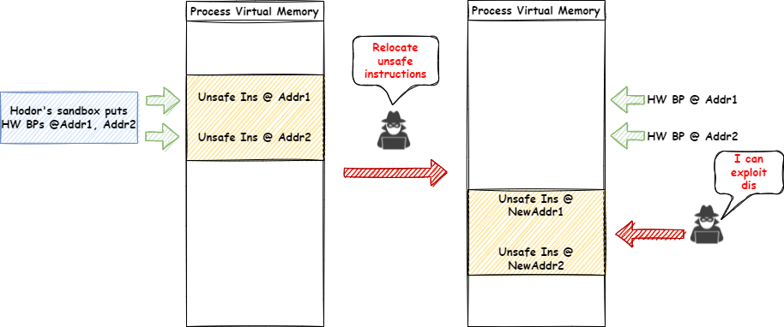
Vetted Unsafe Instruction Relocation
Notes:
Let’s see our first attack. Assume a process that contains two unsafe instructions.

Slide 30
Vetted Unsafe Instruction Relocation
Notes:
Hodor’s sandbox puts hardware breakpoints on these unsafe instructions to vet them at run-time.

Slide 31
Vetted Unsafe Instruction Relocation
Notes:
An attacker can relocate this code, but Hodor’s sandbox doesn’t update the hardware breakpoints to point to the new addresses of these instructions.

Slide 32
Vetted Unsafe Instruction Relocation
Notes:
Consequently, an attacker can exploit them.

Slide 33
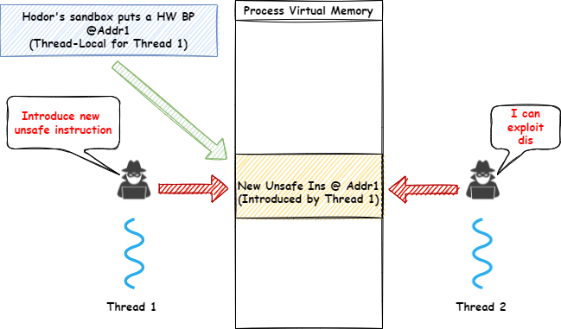
Incomplete Debug Register Update
Notes:
Our second attack takes advantage of the fact that hardware breakpoints are thread-local.
Assume an attacker that controls Thread 1,

Slide 34
Incomplete Debug Register Update
Notes:
and introduces a new unsafe instruction.

Slide 35
Incomplete Debug Register Update
Notes:
Hodor’s sandbox sets a breakpoint in the local thread context when it discovers a new unsafe instruction.
However, updated hardware breakpoints are not propagated to the other threads.

Slide 36
Incomplete Debug Register Update
Notes:
As a result, an attacker can abuse this unsafe instruction from another thread.

Slide 37
Introducing Cerberus
A Framework for PKU-based Sandboxing
Notes:
To solve these problems, we introduce Cerberus: A framework for PKU-based sandboxing.

Slide 38
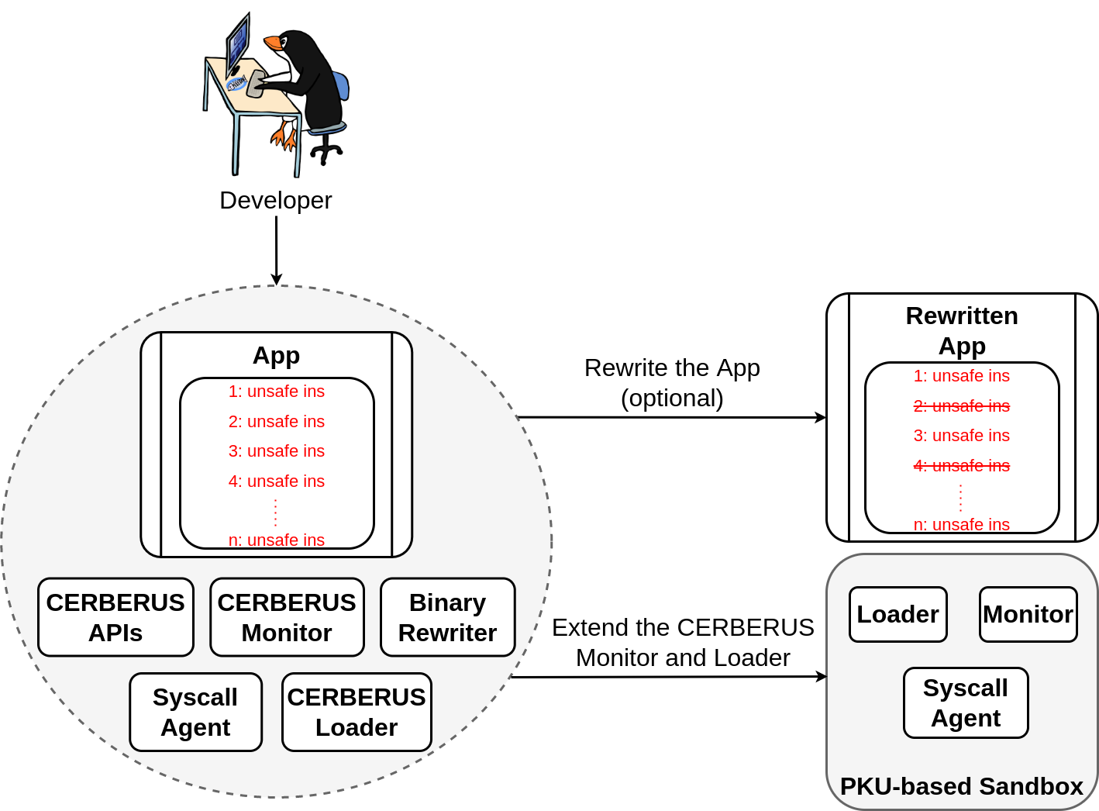
Cerberus’ Components
Notes:
Cerberus contains the following components:
A binary rewriter, an in-kernel syscall agent, a ptrace-based monitor, an application loader, and a set of APIs.

Slide 39
Cerberus’ Components
Notes:
Cerberus contains the following components:
A binary rewriter, an in-kernel syscall agent, a ptrace-based monitor, an application loader, and a set of APIs.

Slide 40
Cerberus’ Components
Notes:
Cerberus contains the following components:
A binary rewriter, an in-kernel syscall agent, a ptrace-based monitor, an application loader, and a set of APIs.

Slide 41
Cerberus’ Components
Notes:
Cerberus contains the following components:
A binary rewriter, an in-kernel syscall agent, a ptrace-based monitor, an application loader, and a set of APIs.

Slide 42
Cerberus’ Components
Notes:
Cerberus contains the following components:
A binary rewriter, an in-kernel syscall agent, a ptrace-based monitor, an application loader, and a set of APIs.

Slide 43
Cerberus’ Components
Notes:
Cerberus contains the following components:
A binary rewriter, an in-kernel syscall agent, a ptrace-based monitor, an application loader, and a set of APIs.

Slide 44
Cerberus’ Components
Notes:
A developer can optionally use the binary rewriter to eliminate as many unsafe instructions as possible from the compartmentalized application.

Slide 45
Cerberus’ Components
Notes:
Then the developer can use the provided APIs to extend the monitor and the loader components to build a PKU-based sandbox that is tailored to a PKU-based memory isolation scheme.

Slide 46
Basic PKU-based Sandbox
The monitor injects the loader into the application
The loader maps a special code page containing an rdpkru instruction
The loader initializes the syscall agent
Providing a list of system calls that should be monitored (SList)
Providing a list of sensitive files that should not be accessed (IList)
The loader completes application loading
Notes:
The syscall agent along with the default implementations of the monitor and the loader form a basic PKU-based Sandbox.
Let’s see its initialization phase.
Before launching the application, the monitor first injects the loader.
Then the loader maps a special code page that contains an rdpkru instruction. The loader also initializes the syscall agent providing two easily configurable lists: SList a list of system calls, and IList a list of sensitive files,
And it completes application loading.

Slide 47
Basic PKU-based Sandbox (2)
modify_ldt, prctl, seccomp, ptrace, process_
vm_readv, process_vm_writev, mprotect, pkey_-
mprotect, pkey_alloc, pkey_free, mmap, munmap, mremap, execve, shmat, shmdt, and all variants of the fork/clone system
"
The monitor uses the rdpkru instruction that the loader mapped to reliably determine the current executing domain
The syscall agent decides how system calls are dispatched
Forwards system calls included in SList to the monitor
Allows the rest to execute natively
The syscall agent blocks opening of sensitive files included in IList
The monitor blocks specific system calls from U
modify_ldt, prctl setting seccomp, seccomp, ptrace, pkey_alloc, pkey_free, pkey_mprotect, process_vm*, shmat and shmdt
Notes:
At run time the sandbox intercepts and monitors system calls to block potential attackers.
Specifically, the syscall agent decides how system calls are dispatched.
The agent forwards to the monitor the systems calls included in Slist,
And allows the rest to run natively.
In addition, the agent blocks opening of sensitive files like /proc/self/mem included in Ilist.
*Silence*
When a system call is forwarded to the monitor, it should decide what to do with it.
The monitor uses the rdpkru instruction that the loader mapped before to reliably determine the current executing domain, and blocks specific system calls from the untrusted code (you can check our paper for more details).

Slide 48
Basic PKU-based Sandbox (3)
The monitor uses a modified version of Hodor’s instruction vetting scheme
Implemented in user space with ptrace
Vets both wrpkru and xrstor instructions
Intercepts and monitors system calls from U that could introduce unsafe instructions
Ensures that hardware breakpoints are properly updated when a process relocates code
Notes:
Another core functionality of the sandbox is to handle unsafe instructions. Specifically, the monitor uses a modified version of Hodor’s instruction vetting scheme that leverages hardware breakpoints. Unlike Hodor, this scheme is implemented in user space and vets both wrpkru and xrstor instructions that can modify PKRU. The monitor also intercepts system calls from the untrusted code that could introduce unsafe instructions, and ensures that hardware breakpoints are properly updated during code relocations.

Slide 49
Basic PKU-based Sandbox (4)
The monitor restricts or modifies mapped regions
Enforces W^X
Doesn’t allow PROT_EXEC && (MAP_SHARED | MAP_SHARED_VALIDATE)
Replaces the file-backed mappings with MAP_ANONYMOUS ones
Copies the file contents that the application initially attempted to map
Notes:
As we showed before attackers could exploit specific combinations of memory mappings to bypass PKU-based memory isolation schemes.
To stop such attacks the monitor restricts or modifies mapped regions. For example, the monitor doesn’t allow executable mappings that are shared, and replaces all the file-backed mappings with anonymous ones.

Slide 50
Basic PKU-based Sandbox (5)
Protecting multi-threaded applications is challenging
Race conditions in memory scanning
Hardware breakpoints are thread local
We spawn a unique monitor for each application thread
We use locks to avoid race conditions in memory scanning
We augment hardware breakpoints with instruction emulation^{[1]}
[1] Vinck et al. Sharing is Caring: Secure and Efficient Shared Memory Support for MVEEs, EuroSys 2022
Notes:
Finally, one of the biggest challenges of PKU-based sandboxing is to protect multi-threaded applications.
To deal with race condition, we spawn a unique monitor for each application thread,
And we also use locks to correctly order monitor operations and avoid such race conditions. To deal with attackers that want to exploit the fact that hardware breakpoints are thread local, we augment hardware breakpoints with instruction emulation.
When the monitor discovers a new unsafe instruction in a multi-threaded program, it first marks the page that contains it as non-executable, and emulates the instructions of that page if the program attempts to use them. For this purpose, we adapted the emulation engine that Vinck et al. implemented for another paper that was presented in EuroSys this year. (for more details you can check our paper)

Slide 51
The Cerberus APIs
"
"
The monitor does not implement a mechanism to reliably track pages which are in M_{T}. Consequently, M_{T} is empty by default. The developer should use the Cerberus APIs to build such a mechanism
The monitor assumes that the application always executes code in U. The developer should use the Cerberus APIs to define the PKRU values that correspond to U and T respectively, and extend the monitor
"
The monitor considers all wrpkru and xrstor instructions as unsafe, except those included in a configurable list (AllowList). The AllowList is empty by default. The developer should use the Cerberus APIs to modify the AllowList
Notes:
So now the question that comes in mind is why do developers need to use our APIs to extend the basic PKU-based sandbox? The answer is simple. We designed this sandbox to be agnostic to the underlying memory isolation scheme.
Consequently, the developers should use the provided APIs to define the PKRU values that correspond to the untrusted and the trusted code, implement a mechanism that reliably tracks the trusted memory, and define a list of PKRU-modifying instructions that the monitor should consider safe.
***Additional content***
First, the developer should use the Cerberus APIs to define the PKRU values that correspond to the untrusted and the trusted components, otherwise the monitor assumes that the application always executes untrusted code. Second the monitor does not implement a mechanism to reliably track the trusted memory. So, the developer again should use the Cerberus APIs to build it.
Third, the monitor considers all wrpkru and xrstor instructions as unsafe. The developer should use the provided APIs to define a list of instructions that the monitor should consider safe.

Slide 52
The Cerberus APIs (2)
Configuration of the syscall agent
Definition of U and T
Identification of the current executing domain
System call handling
Modification of the AllowList
Emulation engine
Notes:
Cerberus provides a rich set of abstractions, in the form of macros and functions, to help the developers to extend the basic PKU-based sandbox.
For example, developers can use macros to insert hooks before and after the execution of certain system calls.

Slide 53
Implementation
≈11 KLOC (C/C++ and shell scripts)
Syscall agent is a small kernel patch for Linux 5.3
Implemented on top of related research projects^{[1,2]}
[1] Volckaert et al. Secure and efficient application monitoring and replication, USENIX ATC 2016 [2] Vinck et al. Sharing is Caring: Secure and Efficient Shared Memory Support for MVEEs, EuroSys 2022
Notes:
Cerberus consists of about 11 thousand lines of code.
We implemented the syscall agent as a small kernel patch for Linux 5.3. and Our work is built on top of related research projects.

Slide 54
Use Cases
PKU-based sandboxes for ERIM and XOM-Switch
ERIM’s sandbox implemented in ≈55 LOC of C/C++ code
XOM-Switch’s sandbox implemented in ≈16 LOC of C/C++ code
Notes:
We used our APIs to build with minimal effort PKU-based sandboxes for ERIM and XOM-Switch. Due to time constraints, I did not describe XOM-Switch in this presentation. But in a nutshell, it is an open-source tool from Intel that applies eXecute only memory to x86 binaries using PKU.
***Additional content***
ERIM’s sandbox required about 55 lines of additional code, while XOM-Switch’s sandbox required about 16 lines of code. XOM-Switches sandbox protects it from attackers that want to abuse PKU to disable XOM, without requiring an additional defense like CFI. To our knowledge, we are the first to build such a sandbox.

Slide 55
Performance Evaluation
Notes:
We evaluated the performance of our constructed sandboxes on different applications and scenarios.
Specifically, we used ERIM to isolate sensitive state of two popular compiler protections,

Slide 56
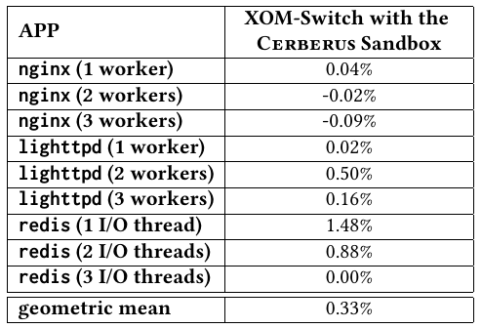
Performance Evaluation
Notes:
and to isolate openssl keys. Then, we replaced ERIM’s sandbox with ours, and we tested its performance on popular server applications.
Additionally, we used XOM-Switch to apply execute only memory to popular server applications, and we used our sandbox to protect it.
Our results indicate that the constructed sandboxes introduce almost no runtime overhead, on top of the underlying memory isolation schemes.

Slide 57
Security Evaluation
[21] Connor et al. PKU Pitfalls: Attacks on PKU-based Memory Isolation Systems, USENIX Security, 2020
Notes:
We also verified that the developed sandboxes stop all known and new attacks except for signal context attacks. We discuss potential solutions to stop signal context attacks in our paper.
***Additional content***
We also analyzed the security of the constructed sandboxes on existing proof-of-concept attacks and the two additional attacks that we discovered while building Cerberus. We verified that the developed sandboxes stop all known attacks except for signal context attacks. We discuss potential solutions to stop signal context attacks in our paper.
***Additional content***
For the former, we used the open-source implementation of the exploits, while for the latter we used our proof-of-concept exploits.

Slide 58
Comparison of PKU-based Sandboxes
Notes:
Finally, we compared our constructed sandboxes with the ones provided by ERIM and Hodor, to show that Cerberus overcomes limitations of existing work regarding security and usability.
***Additional content***
Our sandboxes are the first PKU-based sandboxes that can handle unsafe instructions without causing security or usability issues, and they are also the first ones that prevent the attacks described by previous work and the two attacks we discovered while building Cerberus

Slide 59
Conclusion
Analysis of PKU-based sandboxing challenges
Known challenges
New challenges
Cerberus: A PKU-based sandboxing framework
Built sandboxes for ERIM and XOM-Switch
Evaluated the constructed sandboxes
Notes:
To conclude, We analyzed known challenges of PKU-based sandboxing and we also discovered new ones.
We built Cerberus: A PKU-based sandboxing framework that improves the state-of-the-art of PKU-based sandboxing, And we used it to build sandboxes for ERIM and XOM-Switch with minimal effort.
Finally, we evaluated the security and the performance of the constructed sandboxes.

Slide 60
Cerberus is available!!! https://github.com/ku-leuven-msec/The-Cerberus-Project
Alexios Voulimeneas alex.voulimeneas@kuleuven.be twitter: @systemsgreek
Figure from teeturtle.com
Notes:
This is the end of my talk. I would be happy to answer your questions.

Slide 61
Compartmentalization
Compartmentalize programs in trusted (T) and untrusted components (U)
Isolate U from T to guarantee confidentiality and integrity of sensitive program state/data
Notes:
A good practice to deal with such vulnerabilities is to compartmentalize programs In trusted and untrusted components or T and U, and isolate U from T.
Or +
The insight here is to isolate U from T to guarantee confidentiality and integrity of sensitive program state or data.
For example this approach can be used to isolate cryptographic keys and stop attacks like the notorious heartbleed.

Slide 62
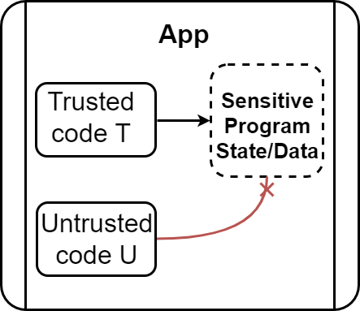
Compartmentalization
Compartmentalize programs in trusted (T) and untrusted components (U)
Isolate U from T to guarantee confidentiality and integrity of sensitive program state or data
Notes:
State is always vulnerable e.g., cryptographic keys
Talk about heartbleed here
That is why people explored compartmentalization techniques …
Explain that sensitive program state/data of T (may need to change picture). I have the draw io in pictures

Slide 63
Basic PKU-based Sandbox
The monitor injects the loader into the application
The loader maps a special code page
This page contains an rdpkru instruction
Used to implement a ptrace-based interface to read PKRU
The loader initializes the syscall agent
Providing a list of system calls that should be monitored (SList)
Providing a list of sensitive files that should not be accessed (IList)
Both lists are easily configurable through the Cerberus APIs
Notes:
The syscall agend along with the default implementations of the monitor and the loader form a basic PKU-based Sandbox.
At first the monitor injects the loader into the application.
Then the loader maps a special code that the ptrace-based monitor can use to reliably access the PKRU register

Slide 64
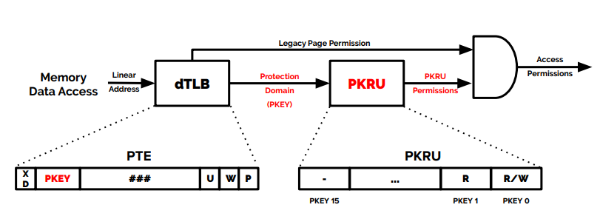
Memory Protection Keys for Userspace (PKU)
Tag memory pages with one of 16 available protection keys (pkey_mprotect)
New unprivileged 32-bit register (PKRU)
Thread local
Two bits (access disable, write disable) for each key
Hardware checks PKRU at every memory access
Accessed with new instructions: wrpkru, rdpkru
Accessed with xrstor (if bit 9 of eax register is set)
Based on a figure from https://ubm.io/2YjGvFE
Notes:
PKU is a hardware feature that is available on recent Intel and AMD server and desktop CPUs

Slide 65
PKU
Tag memory pages with one of 16 available protection keys (pkey_mprotect)
New unprivileged 32-bit register (PKRU)
Thread local
Two bits (access disable, write disable) for each key
Hardware checks PKRU at every memory access
Accessed with new instructions: wrpkru, rdpkru
Accessed with xrstor (if bit 9 of eax register is set)
Based on a figure from https://ubm.io/2YjGvFE
Notes:
It allows tagging of memory pages with one of 16 available protection keys
Or+
with a pkey_mprotect, a new system call

Slide 66
PKU
Tag memory pages with one of 16 available protection keys (pkey_mprotect)
New unprivileged 32-bit register (PKRU)
Thread local
Two bits (access disable, write disable) for each key
Hardware checks PKRU at every memory access
Accessed with new instructions: wrpkru, rdpkru
Accessed with xrstor (if bit 9 of eax register is set)
Based on a figure from https://ubm.io/2YjGvFE
Notes:
PKU adds a new user-mode, 32-bit wide register (PKRU)
PKRU has two bits for each protection key that correspond to the access permissions of the pages that are tagged with this key.
And These bits are checked during memory accesses for all the pages that are associated with a key.
Since We can read and modify the PKRU register with xrstor or new unprivileged instructions; rdpkru and wrpkru,
a program can quickly enable/disable access to memory domains that are associated with the protection keys
Or
PKRU is a 32 bit wide, thread-local register, and has two bits for each protection key that correspond to the access permissions of the pages that are tagged with this key.

Slide 67
PKU
Tag memory pages with one of 16 available protection keys (pkey_mprotect)
New unprivileged 32-bit register (PKRU)
Thread local
Two bits (access disable, write disable) for each key
Hardware checks PKRU at every memory access
Accessed with new instructions: wrpkru, rdpkru
Accessed with xrstor (if bit 9 of eax register is set)
Based on a figure from https://ubm.io/2YjGvFE
Notes:
And These bits are checked during memory accesses for all the pages that are associated with a key.

Slide 68
PKU
Tag memory pages with one of 16 available protection keys (pkey_mprotect)
New unprivileged 32-bit register (PKRU)
Thread local
Two bits (access disable, write disable) for each key
Hardware checks PKRU at every memory access
Accessed with new instructions: wrpkru, rdpkru
Accessed with xrstor (if bit 9 of eax register is set)
Based on a figure from https://ubm.io/2YjGvFE
Notes:
Since We can read and modify the PKRU register with xrstor or new unprivileged instructions; rdpkru and wrpkru,
a program can quickly enable/disable access to memory domains that are associated with the protection keys
or
We can access the PKRU register with unprivileged instructions; rdpkru for read and wrpkru for write accesses
The xrstor instruction can also update the PKRU register if bit 9 in the eax register is set prior to the instruction execution
This allows a program to quickly enable/disable access to memory domains that are associated with the protection keys without having to pay the high cost of the system calls and TLB invalidations required to change page permissions through conventional means.

Slide 69
XOM
Protection Keys can be used for eXecutable Only Memory (XOM)
Effective mitigation against advanced code-reuse attacks that rely on reading code
Support of XOM in Linux 4.9+
mprotect(addr, PROT_EXEC) makes code pages executable only
Notes:
https://vivek-arora.com/?p=457&fbclid=IwAR3TUpo1hASC6oWin-glONbSoJgotzpoCz6Wo1vnI8PaUiVJOvvBlZA89wM
https://stackoverflow.com/questions/8879540/if-a-virtual-memory-page-is-executable-does-it-imply-that-it-is-readable?fbclid=IwAR1BHfO7yy6TxKl2L_EY42ktQVgJUxnNyvx-FjYx6NG8-KSjBUFp9O0NcUY
So let’s see an example. PKU can be used for eXecute only memory that is an effective mitigation against advanced code-reuse attacks that rely on reading capabilities
Finally, In modern linux kernel we can make code pages executable only, using an enhanced version of mprotect system call

Slide 70
XOM
Protection Keys can be used for eXecutable Only Memory (XOM)
Effective mitigation against advanced code-reuse attacks that rely on reading code
Support of XOM in Linux 4.9+
mprotect(addr, PROT_EXEC) makes code pages executable only
Support of XOM is missing in both libc and compiler!
Notes:
https://vivek-arora.com/?p=457&fbclid=IwAR3TUpo1hASC6oWin-glONbSoJgotzpoCz6Wo1vnI8PaUiVJOvvBlZA89wM
https://stackoverflow.com/questions/8879540/if-a-virtual-memory-page-is-executable-does-it-imply-that-it-is-readable?fbclid=IwAR1BHfO7yy6TxKl2L_EY42ktQVgJUxnNyvx-FjYx6NG8-KSjBUFp9O0NcUY
However we sill miss support of XOM in the development toolchains.

Slide 71
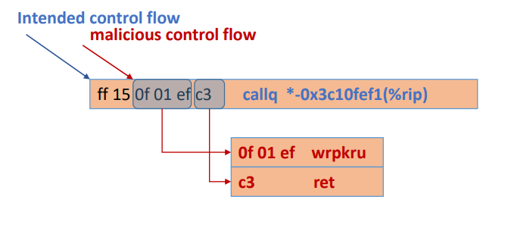
XOM-Switch
Patches dynamic loader and libc
Works on large applications
Almost no runtime overhead
The defense is limited in power
Attackers can use unsafe instructions to disable XOM
… “Ultimate”^{[1,2]} solution: Intel CET
Based on a figure from https://ubm.io/2YjGvFE
[1] Intel CET enables weak CFI policies – grsecurity. Close, but No Cigar: On the Effectiveness of Intel's CET Against Code Reuse Attacks, 2016 [2] Intel CET introduces non negligible overhead (2-8%) – Im et al.The Endokernel: Fast, Secure, and Programmable Subprocess Virtualization, 2021
Notes:
XOM-Switch is a tool that tries to solve that problem transparently by patching the dynamic loader and libc.
it was proven to scale on large applications like broswers.
And it add almost no runtime overhead
The defense is limited in power, though, since attackers can still use unsafe instructions to disable XOM.
The authors proposed to combine Intel CET with PKU to block such attacks. But previous and concurrent work that Intel CET enables weak CFI policies that can be bypassed and adds non negligible overhead.

Slide 72
Use Case 1 – A Sandbox for ERIM
Define the same PKRU values as ERIM for U and T
Add ERIM’s call gates to the AllowList
T uses pkey_mprotect to tag pages of M_{T} with T’s key
Intercept and monitor pkey_mprotect to reliably track pages of M_{T}
Implemented in ≈55 LOC of C/C++ code

Slide 73
Table
Protection Key | PKEY 15 |  |  | PKEY 2 |  | PKEY 1
Access/Write Disable | WD | AD | … | WD | AD | WD | AD
Bits | 0 | 0 |  | 0 | 0 | 0 | 0
PKEY 2 |  | PKEY 1 |  | PKEY 0
WD | AD | WD | AD | WD | AD
0 | 0 | 0 | 0 | 0 | 0

Slide 74
Use Case 2 – A Sandbox for XOM-Switch
U includes all the code
Empty AllowList
M_{T} contains all XOM memory
Intercept and monitor mprotect(addr, PROT_EXEC) to reliably track pages of M_{T}
Implemented in ≈16 LOC of C/C++ code

