Slide 1
Sharing is Caring: Secure and Efficient Shared Memory Support for MVEEs
Jonas Vinck imec-DistriNet, KU Leuven Belgium | Bert Abrath Ghent University Belgium | Bart Coppens Ghent University Belgium
Alexios Voulimeneas imec-DistriNet, KU Leuven Belgium | Bjorn De Sutter Ghent University Belgium | Stijn Volckaert imec-DistriNet, KU Leuven Belgium

Slide 3
Exploiting Memory Vulnerabilities
Program
Stack
0x7ffdeadbeef
0x7ffdeadbe2e
0x7ffdeadbef4
0x7ff80085840

Slide 4
Software Diversity
!
!
Program
Stack
0x7ffbeefdead
0x7ffbeefddec
0x7ffbeefdeb2
0x7ffdeadbeef
0x7ffdeadbe2e
0x7ffdeadbef4
0x7ff80085840

Slide 5
Multi-Variant Execution Environments (MVEEs)
Program
Program
!
Stack
Stack
0x7ffdeadbeef
0x7ffdeadbe2e
0x7ffdeadbef4
0x7ffdeadbeef
0x7ffdeadbe2e
0x7ffdeadbef4
0x7ff80085840
0x7ff1e555840

Slide 6
Multi-Variant Execution Environments (MVEEs)
Program
Program
Run multiple variants in parallel
Suspend at every system call
Rendezvous point
Three tasks
Monitoring
Replication
Transparency
t
t
brk
write
brk
write
Monitor
Kernel

Slide 7
MVEE Adoption Issues
CPU time stamp counter and random number generators
Virtual system call interface
Asynchronous signal delivery
Variant address space layout
Multithreading
Address sensitive behaviour
Shared memory inter-process communication
CPU time stamp counter and random number generators
Virtual system call interface
Asynchronous signal delivery
Variant address space layout
Multithreading
Volckaert et al. 2017. Taming parallelism in a multi-variant execution environment. In Proceedings of the ACM European Conference on Computer Systems (EuroSys).
Volckaert et al. 2016. Cloning your gadgets: Complete ROP attack immunity with multi-variant execution. IEEE Transactions on Dependable and Secure Computing (TDSC) (2016).
Volckaert et al. 2012. GHUMVEE: efficient, effective, and flexible replication. In International Symposium on Foundations and Practice of Security (FPS).
Jacobs, et al. Combating Address-Sensitive Behaviour in MVEEs. KU Leuven. Faculteit Industriële Ingenieurswetenschappen, 2021.

Slide 8
Shared Memory Inter-Process Communication
Program 1
Program 2

Slide 9
Shared Memory Usage in the Wild

Slide 10
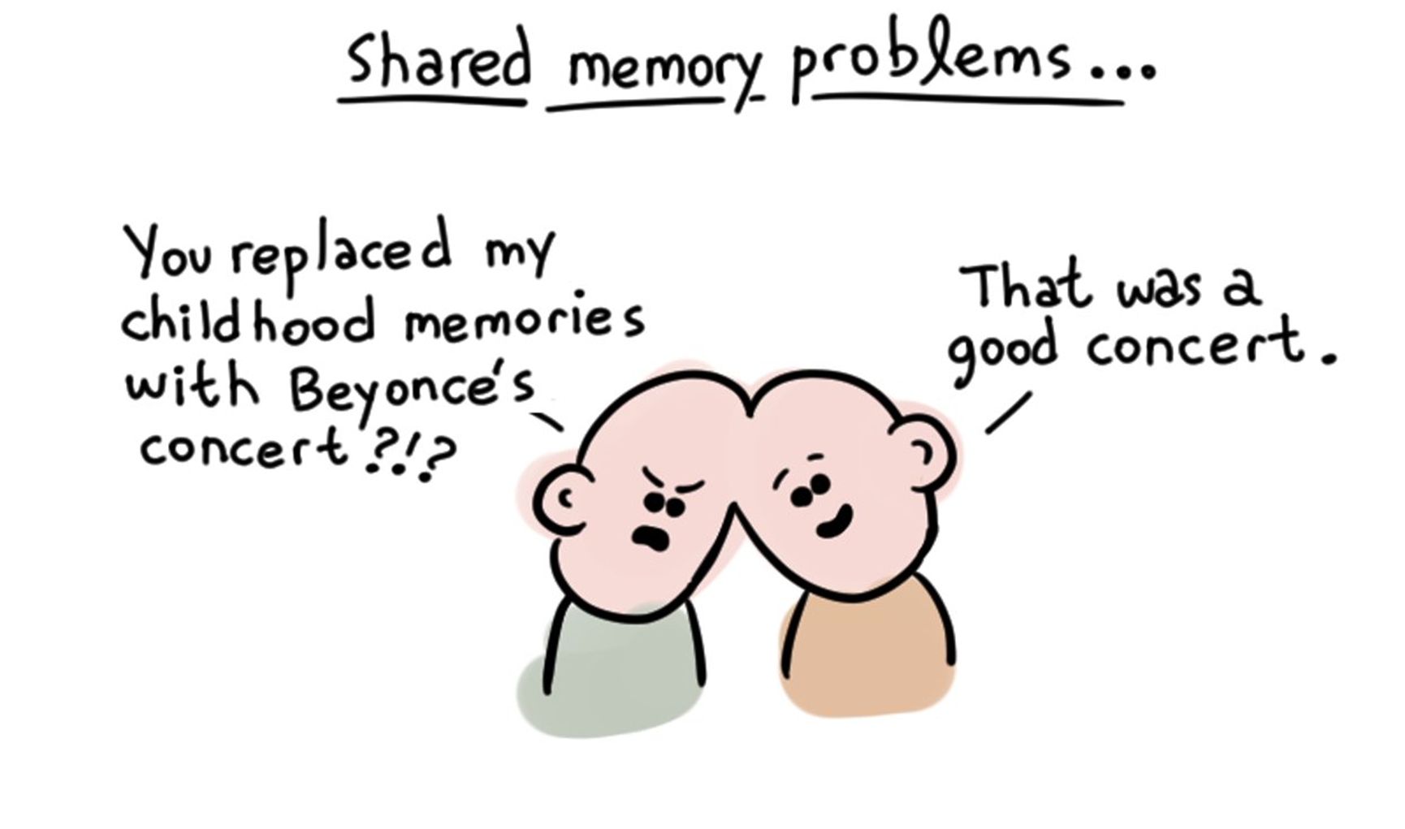
Shared Memory in MVEEs
Program
Program 2
Program
Data
Data + operation
Data
Data + operation
Monitor

Slide 11
Cross-Process Handler
... *pointer
...
... *pointer
...
0x0007ff0380084200
0x8000000000000000
0x0eadbeef00000000
0x8eaa41ec80084200
0x0007ff0380084200
0x8000000000000000
0x0eefdead00000000
0x8ee821ae80084200
!
!
Same instruction?
Same source operands?
Same location in shared memory?
Monitor

Slide 12
In-Process Handler
...
if shm access call agent
else
*pointer
...
...
if shm access call agent
else
*pointer
...
... *pointer
...
... *pointer
...
In-process agent
In-process agent
0x8eaa41ec80085342
0x8000000000000000
0x0eadbeef00000000
0x0007ff0380085342
Monitor

Slide 13
In-Process Handler
List of instructions
Source code
Run under MVEE
Recompile
Binary
Wrapped
binary
Rewrite

Slide 14
Diversified Data in Shared Memory
... *pointer
...
... *pointer
...
0x0007ff0380084200
0x8000000000000000
0x0eadbeef00000000
0x8eaa41ec80084200
0x0007ff0380084200
0x8000000000000000
0x0eefdead00000000
0x8ee821ae80084200
Same instruction?
Same source operands?
Same location in shared memory?
Same instruction?
Equivalent source operands?
Same location in shared memory?
Monitor

Slide 15
Security Challenges
...
if shm access call agent
else
*pointer
...
...
if shm access call agent
else
*pointer
...
... *pointer
...
... *pointer
...
In-process agent
In-process agent
Monitor

Slide 16
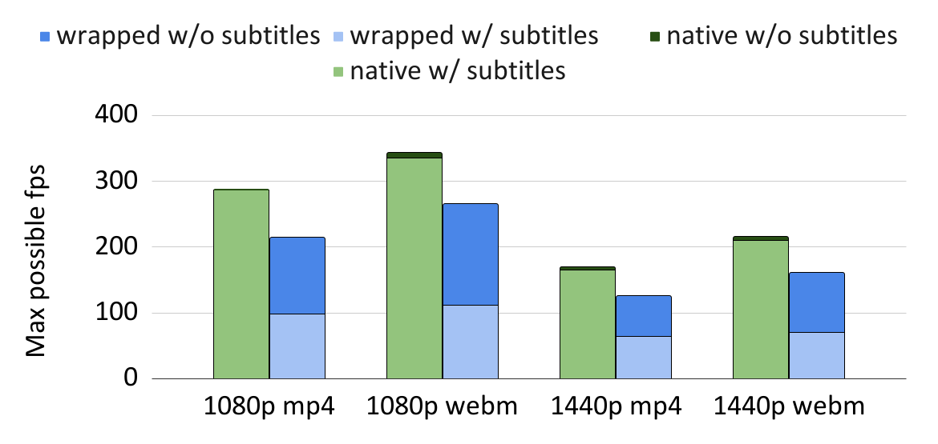
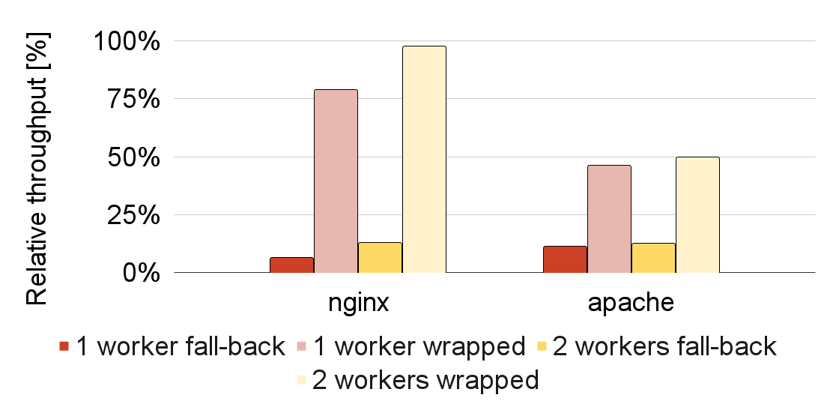
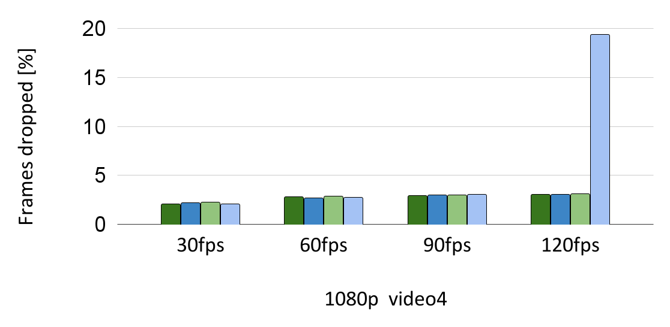
Evaluation Results
64fps
~98%
~50%

Slide 17
0xC3
Jonas Vinck – jonas.vinck@kuleuven.be
https://github.com/ReMon-MVEE/ReMon

